Slide 1
Demand-Side Management through Machine Learning
Submitted in the partial fulfillment for the award of the degree of
BACHELOR OF ENGINEERING
IN
Artificial Intelligence and Machine Learning
Submitted by:
Rishabh Joshi, 20BCS6869
Rahul Kumar, 20BCS6861
Under the Supervision of:
Mr. Prabjot Singh Bali
Department of AIT-CSE
DISCOVER . LEARN . EMPOWER

Slide 2
Outline
Introduction to Project
Problem Formulation
Objectives of the work
Methodology used
Results and Outputs
Conclusion
Future Scope
References

Slide 3
Introduction to Project
Every household requires the need of electricity.
Electricity is required for basic things like: Glowing bulb, watching TV and also needed to charge the phones, using washing machine and other integral parts of our lives.
With this project in hand, we wanted to find the patterns in the usage of electricity based on the time of the year, and the usage of electricity based on the time of the day.
The first challenge that we faced while building the project is to understand the behavior of the data. The size of data was around 150MB, therefore it had millions of rows and many columns.

Slide 4
1.1 Machine Learning
Machine learning (ML) is a powerful subfield of artificial intelligence (AI) that empowers computers to learn from data without explicit programming. Unlike traditional software that relies on pre-defined rules, ML algorithms are like students constantly studying and improving based on the information they're exposed to.
1.2 Fourier Transform
The Fourier Transform (FT) is a powerful mathematical tool used to analyze signals, often those that appear complex at first glance. Imagine a sound wave – like the roar of a crowd at a sporting event. It might seem like a chaotic jumble of noise, but the FT can break it down into its fundamental building blocks: Frequencies. Think of a sound wave as a musical composition. Each instrument plays at a specific frequency, creating its unique tone. The FT acts like a conductor, revealing the individual frequencies present in the overall sound and their relative strengths. It tells us how much each frequency contributes to the overall sound wave, similar to a spectrum analyzer showing the intensity of different colors in a beam of light.

Slide 5
Problem Formulation
The usage of electricity changes frequently everyday.
It is not possible to accurately predict the everyday electricity usage, for that kind of situation we need quantitative analysis.
Maybe there is a way of finding a pattern in the usage of electricity by the month, or some pattern in the usage according to the time.
Finding a rough pattern can help us analyze the usage of energy better.
The dataset we will be using might not be cleaned. We have to find the important features in the data, and use them for pattern analysis.
Once we find a pattern, we can apply some optimizations like curve fitting and regression analysis to get better grip in data.

Slide 6
Objectives of the Work
The objectives of our project is to find the patterns in the usage of electricity in an average household.
Finding the time at which we utilize the energy the most, can help stations to better store the electricity, so that the voltage at the given time doesn’t become very low.
Better understand the requirement of the electricity based on the time of the year, and the time of utilization.
This project can help predict the usage at the given time ahead-of-time, which can help calculate the cost of doing beforehand.

Slide 7
Methodology
This architecture involves several steps:
• Data Collection:
• Data Preprocessing:
• Feature Engineering:
• Machine Learning Model Training:
• Model Evaluation:
• Deployment:
• User Interface:
• Monitoring and Maintenance:

Slide 8
Methodology
We start by getting the data about the electricity consumption by an average household over a long period of time.
Since the data can have many rows and columns, we need to select the appropriate features for prediction.
After selecting the appropriate feature, we try to reduce the unwanted electricity spikes in the data using the method of signal analysis.
By applying FFT and IFFT, we find a pattern in the usage of data, that shows some pattern in the usage of energy.
Then, we apply optimization techniques to further increase the accuracy of data. This include curve fitting using polynomial and sinusoidal methods.
Fine tune some parameters like the degree of curve used for optimization and the noise datapoints to be removed from the data.
Evaluate the performance of the curve in predicting the energy consumption in the given time.

Slide 9
Methodology
Since, the data size is very large. We start by converting the data into an SQLite table.
SQLite is a database engine, used in many programs to store the state of a program, or performing queries on the data, of which, the size is very large.
We use SQLite to import our table into Python, and start by recognizing the unwanted values and removing them.
Since we need to find pattern in the usage of electricity, we need some numerical methods like average, deviation and convolution to better identify the patterns.
After applying these techniques, we have to analyze the pattern visually tog get better understand the data.
Libraries Used:
There were many libraries used in the project, without them the analysis of data would not be possible. Some of the libraries used for the project are : NumPy, SciPy, Vedo, SQLite and Scikit-learn.

Slide 10
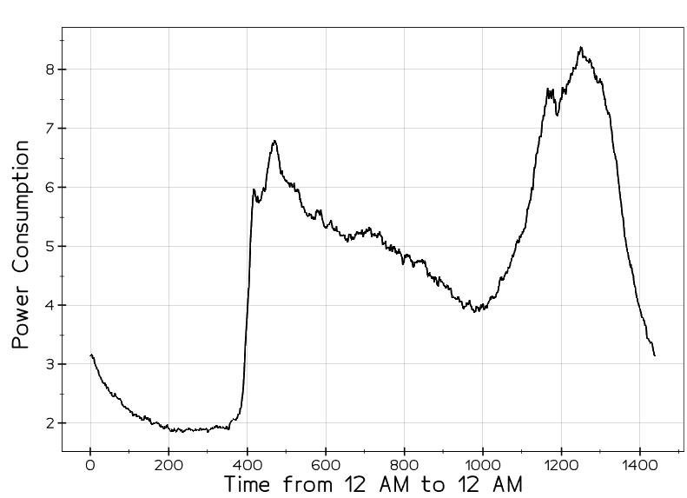
Results
This visual shows the average consumption of electricity starting from 12AM ending again at 12AM.

Slide 11
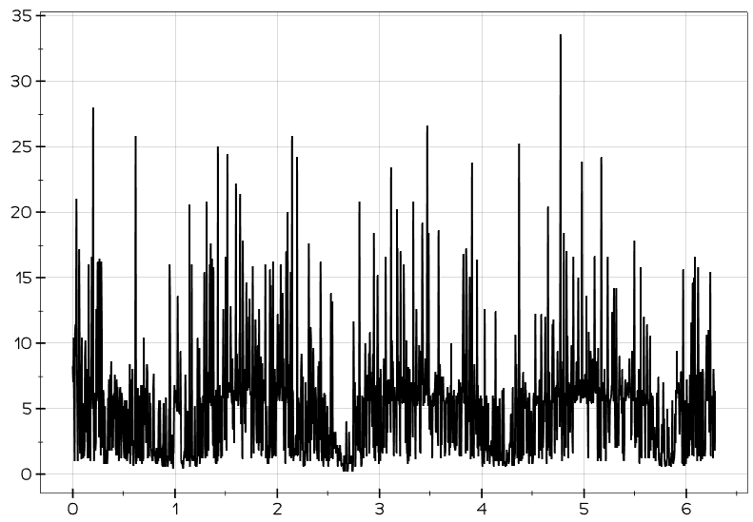
Results and Outputs
This is a plot of energy consumption over a span of 4 years. It is clear that the electricity usage increases with months, and decreases at the end of the year.

Slide 12
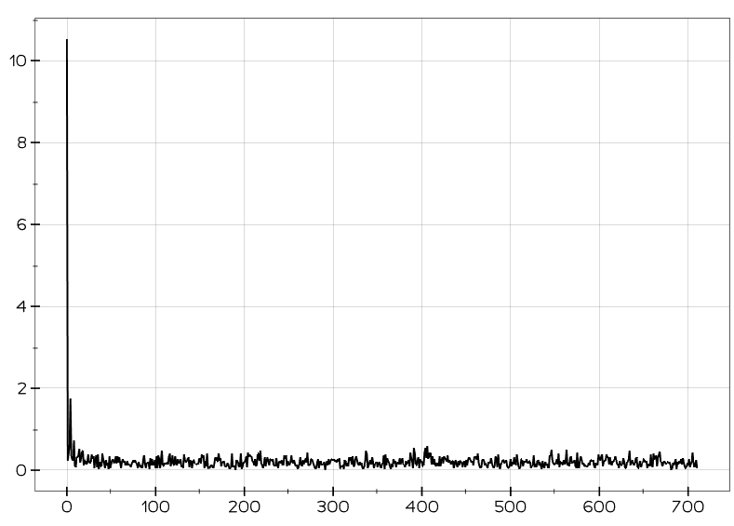
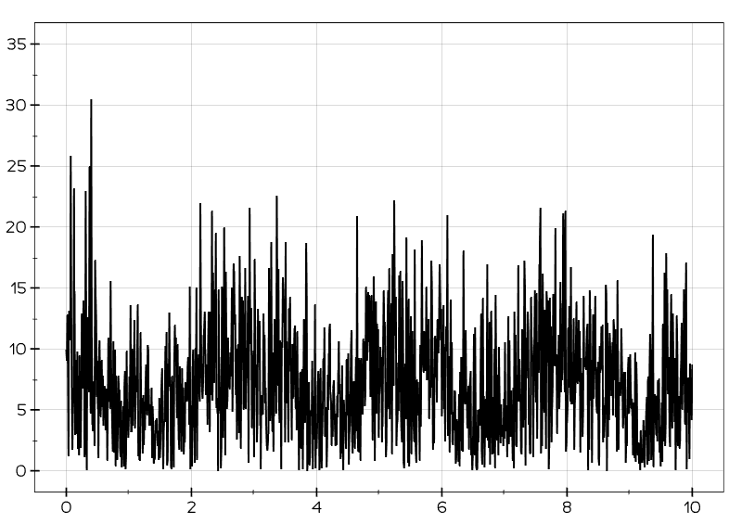
Results and Outputs
The FFT algorithm is used here to filter out some frequencies from the signal, whose presence in the data is negligible. This gives a better understanding of the data.

Slide 13
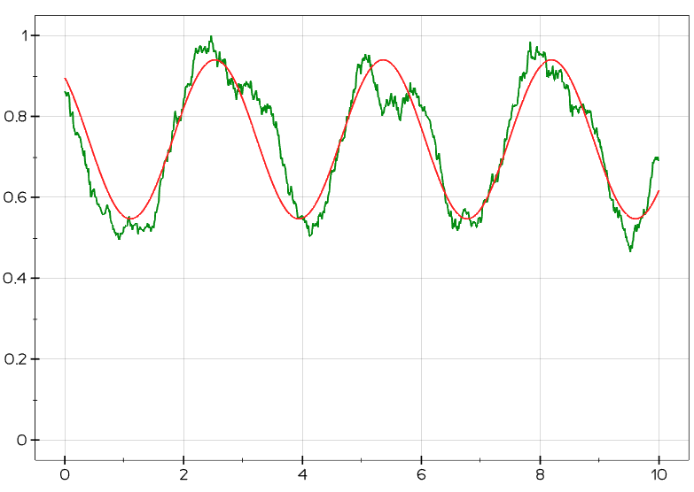
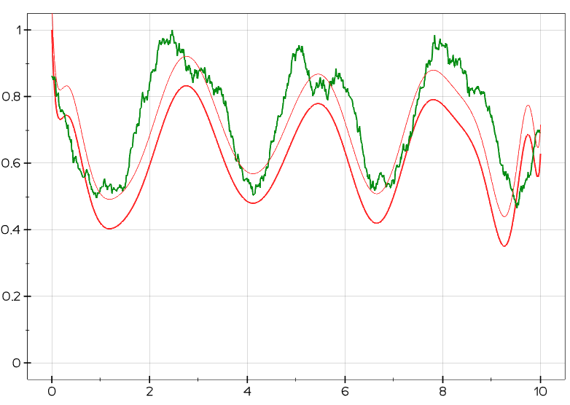
Results and Outputs
After performing rolling mean operations on the data, we fit a polynomial curve and a sinusoidal curve to the data. First plot is a sinusoidal fit, the second one is a polynomial fit.

Slide 14
Conclusion
This project explored the potential of signal processing techniques for predicting demand-side electricity consumption. By leveraging techniques like e.g., Fast Fourier Transform, polynomial regression, sinusoidal fitting, we were able to develop a model that can forecast future electricity consumption patterns. The results demonstrate the effectiveness of signal processing in extracting valuable insights from historical consumption data.
We employed various signal processing techniques in our approach. The Fast Fourier Transform (FFT) was particularly useful for breaking down historical consumption data into its basic frequency components. This decomposition helped us identify hidden patterns and regular fluctuations within the data, revealing factors that influence how electricity demand changes over time.

Slide 15
Future Scope
It was clear that the data had a clear pattern in it. By utilizing the operations of Linear Algebra, we were able to filter out the data and finally get a pattern in the usage of electricity all over the year.
In future, we can use some more rigorous libraries like PyTorch and TensorFlow to apply some deep learning methods to fit the data.
There might be the use of some unsupervised algorithms in the data like KNN or DBSCAN, so we might use them to cluster the data if we find any relations among the clusters.
Many RNN based algorithms and LSTM are also used for time series data. Deep learning libraries contain these kind of algorithm, so that can also be used.

Slide 16
References
Power Consumption Prediction in Urban Areas using Machine Learning as a Strategy towards Smart Cities, AJBAR Vol 1(1), 2022: 11-24, ISSN: 2811-2881. 35
An Overview of Electricity Demand Forecasting Techniques, Vol.3, No.2, 2013-National Conference on Emerging Trends in Electrical, Instrumentation & Communication Engineering.
A deep learning architecture for power management in smart cities, Qin Xin a, Mamoun Alazab b, Vicente García Díaz c, Carlos Enrique Montenegro-Marin d, Rubén González Crespoe.
Strategies for predictive power: Machine learning models in cityscale load forecasting, e-Prime - Advances in Electrical Engineering, Electronics and Energy, Volume 6, December 2023, 100392
Machine learning for modern power distribution systems: Progress and perspectives ,Marija Marković, Matthew Bossart, Bri-Mathias Hodge. Journal of Renewable and Sustainable Energy, Volume 15, Issue 3 May 2023

